Slide 1


Pedro Barcellos
03/04/2022

Slide 2

Outline
Executive Summary
Introduction
Methodology
Results
Conclusion
Appendix

Slide 3
Executive Summary
Summary of methodologies
Usage of python programming to create a Data Collection through API
Web Scrapping with python programming adding to the created Data Collection
Data Wrangling (clean-up \ standardization)
Exploratory Data Analysis (EDA) using Structured Query Language (SQL)
EDA using various forms of Visualization with python programming (plotly)
Interactive Visual Analytics using Folium (python programming)
Machine Learning Prediction
Summary of all results
EDA results
Screenshots from the Interactive Visual Analysis
Predictive Analytics result

Slide 4
Introduction
Project background and context
SpaceX has gained worldwide attention for a series of historic milestones.
It is the only private company ever to return a spacecraft from low-earth orbit, which it first accomplished in December 2010.
SpaceX advertises Falcon 9 rocket launches on its website with a cost of 62 million dollars; other providers cost upward of 165 million dollars each, much of the savings is because SpaceX can reuse the first stage. Therefore, if we can determine if the first stage will land, we can determine the cost of a launch. This information can be used if an alternate company wants to bid against SpaceX for a rocket launch.
Problems you want to find answers
What factors are decisive / key for a successful landing?
Is there any relation between this factors that determines a successful landing?
If so, what is the combination with higher chance for a successful landing?

Slide 5

Section 1

Slide 6
Methodology
Executive Summary
Data collections were created by using python programming to retrieve data from SpaceX API and via web scraping Wikipedia (List of Falcon 9 and Falcon Heavy launches)
Data collected from the API was then “processed” using python Pandas data frames removing the unwanted columns and removing null values – Wangling
Initial EDA using SQL has paved the way to a more in-depth analysis since some relations with the data were already showing up.
These relations were then visually checked in an interactive dashboard using Folium and Plotly Dash
Finally predictive analysis using classification models corroborate to identify and suggest the relations we look for

Slide 7
Data Collection
Data collection was done using various methods via python programming. Utilizing requests library, we retrieved data from SpaceX API in json format, which was then “translated” into Panda data frames creating a “table” from the attributes and values presented on the json response.
Then we narrowed the table contents by excluding unwanted columns, and by calculating some of the values using given premade functions.
Web scraping was performed to gather data from Falcon 9 launch using python BeautifulSoup which were then converted also into Panda data frames to complement the analysis.
Data wrangling was next, when null values were replaced on the dataset by its column mean value (PayloadMass), and initial counts on the grouping of values per Launch Site, Orbit and Outcome, enabled us to classify the data adding a column with the successful (1) of failed (0) outcome.

Slide 8
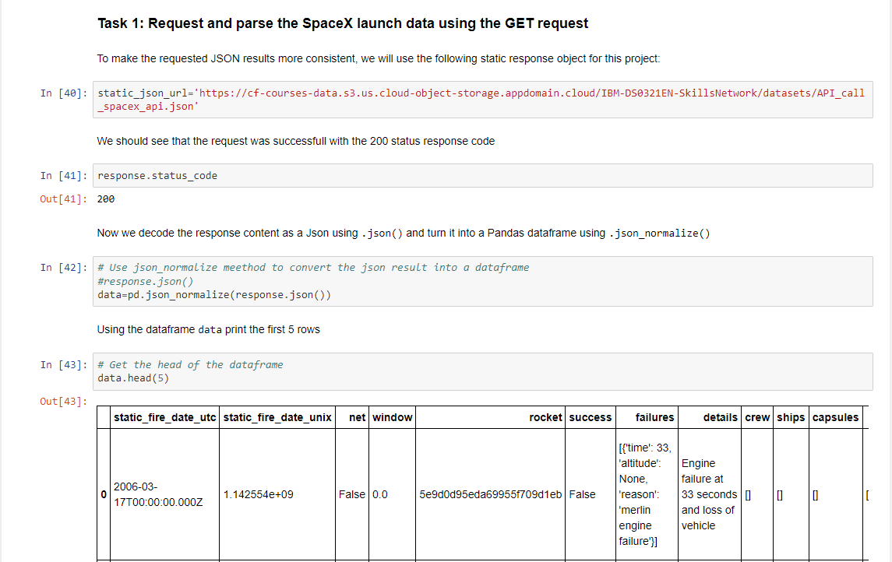
Data Collection – SpaceX API
Using request method and creating a normalized Panda data frame from SpaceX API json response.
GitHub link: SpaceX Collecting Data

Slide 9
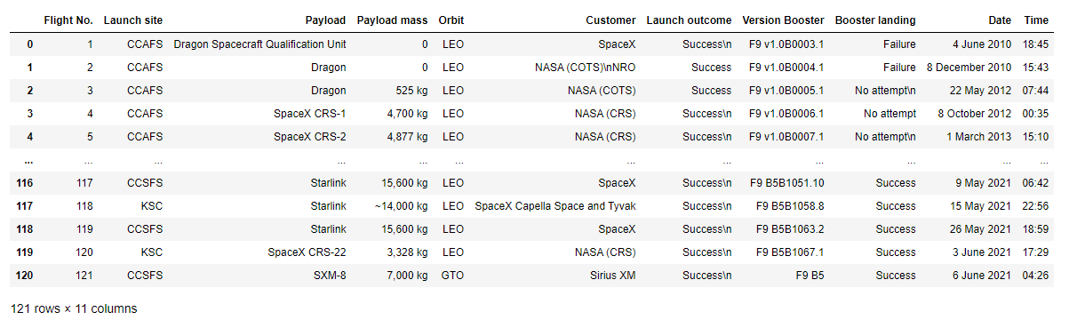
Data Collection - Scraping
Using python BeautifulSoup library we performed webscraping of the Falcon 9 launch records from Wikipedia, parsing the html format into a Panda data frame.
GitHub link: Web Scrapping

Slide 10
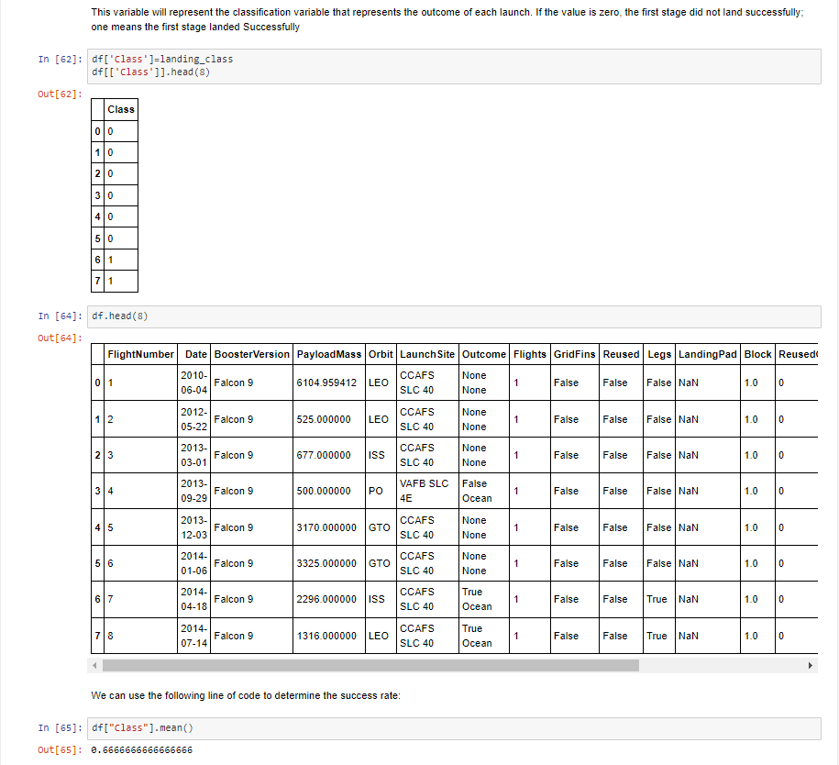
Data Wrangling
EDA was done on top of the data collection of the API combined with the scraped from the Wiki, on form of Panda data frames where null values for PayloadMass were replaced by its mean value, and classification of the Outcome was turned into a new column / attribute called Class where 0 denotes a failed result and 1 a successful one. That allowed us to initiate quantitative analysis of number of successful and unsuccessful launches per Launch Site, and its occurrences per Orbit.
GitHub link: Data Wrangling

Slide 11
EDA with Data Visualization
Here are some of the findings possible with the visual analysis of the linear, bar and scatter plots. By relating Flight number and Launch Site, Orbit and Success ratio (Class).
As a summary we could say that:
The success ratio of SpaceX launches increased in time. (Class x Year graph on next slide)
Recent launches (flight numbers > 40 ) were more prone to success on CCAFS SLC 40 Launch Site;
Early launches (flight numbers 0 to 25) were more prone to fail and were also launched from CCAFS SLC 40;
Fewer launches were done on VAFB SLC 4E than in any other launch site, which proportionally gives it a better success ratio;
KSC LC 39A launch site was only used after the last “twentieths” flight number, failed on CCAFS SLC 40;
Activities returned to launch site CCAFS SLC 40 after the flight number 40 and a good success ratio started after flight number 60.
Orbit PO has higher success rate, followed by ES-L1 then HEO and MEO to SSO then GEO.
LEO, ISS, GTO tie on success rate.
VLEO orbit has only success.
SO orbit has only failed.
GitHub link: Data Visualization

Slide 12
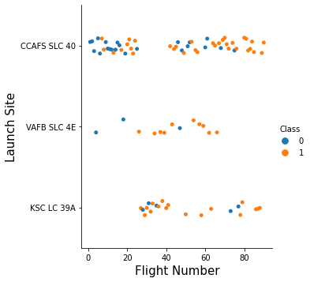
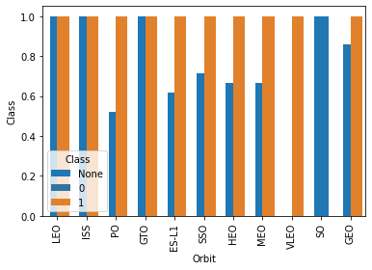
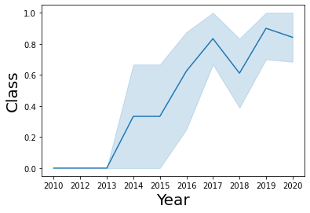
EDA with Data Visualization

Slide 13
EDA with SQL
We loaded the SpaceX csv dataset into IBM PostgreSQL database; GitHub link: EAD with SQL
We used SQL to get some insights from the data:
The names of the unique launch sites in the space mission
First 5 records where launch sites beginning with the string 'CCA’
Total payload mass carried by boosters launched by NASA (CRS)
Average payload mass carried by booster version F9 v1.1
The date when the first successful landing outcome in ground pad was achieved.
Names of the boosters which have success in drone ship and have payload mass greater than 4000 but less than 6000
Total number of successful and failure mission outcomes
Names of the booster versions which have carried the maximum payload mass.
The failed landing outcomes in drone ship, their booster versions, and launch site names for in year 2015
Rank the count of landing outcomes (such as Failure (drone ship) or Success (ground pad)) between the date 2010-06-04 and 2017-03-20, in descending order

Slide 14
Build an Interactive Map with Folium
We plot all Launch Sites on a map using circles, and by using map objects we added markers for success or failed launches, (based on the classification of the Outcome: Class where 0 is fail and 1 success), and lines denoting the calculated distance from launch sites to highways, railroads and closest city. And by using clusters, we shown which launch site had higher success rate.
The goal was to answer some of these questions (where we found it is true):
Are launch sites near railways, highways and / or coastline?
Do launch sites keep certain distance away from cities?
GitHub link: Interactive Map with Folium

Slide 15
Build a Dashboard with Plotly Dash
Dropdown list of Launch Sites for selection and input for the other components that were filtered dynamically
Pie chart to show the total successful launches count for all sites and if / when a specific launch site was selected, show the Success vs. Failed counts for the site
Horizontal slider to select payload range
Scatter chart to show the correlation between payload and launch success
The main goal was to visualize the correlation between Launch site, Payload and Success rate for the SpaceX launches.
GitHub link: Dashboard app

Slide 16
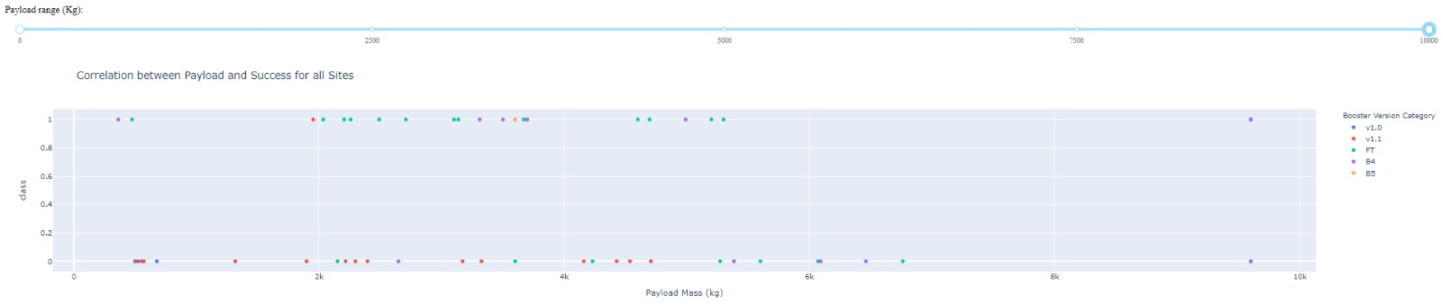
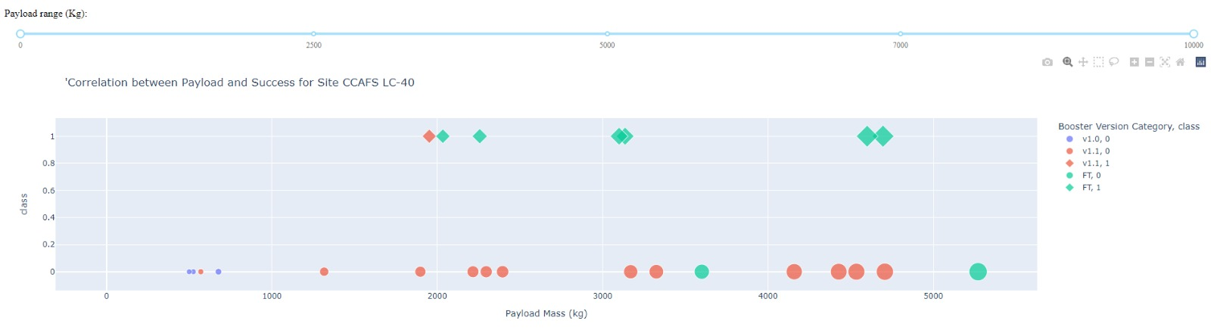
Build a Dashboard with Plotly Dash

Slide 17
Predictive Analysis (Classification)
Data was loaded to data frames using Panda and Numpy, then the data frame was split into test and training data.
A few different machine learning models were built and parametrized using GridSearchCV
The score and accuracy of the models was calculated, and the models improved by it with the usage of Logistics Regression followed by Support Vector machine, Decision Tree, Confusion matrix, Nearst Neighbors
Github link: Predictive Analysis Classification

Slide 18
Results
Exploratory data analysis results
Interactive analytics demo in screenshots
Predictive analysis results

Slide 19

Section 2

Slide 20
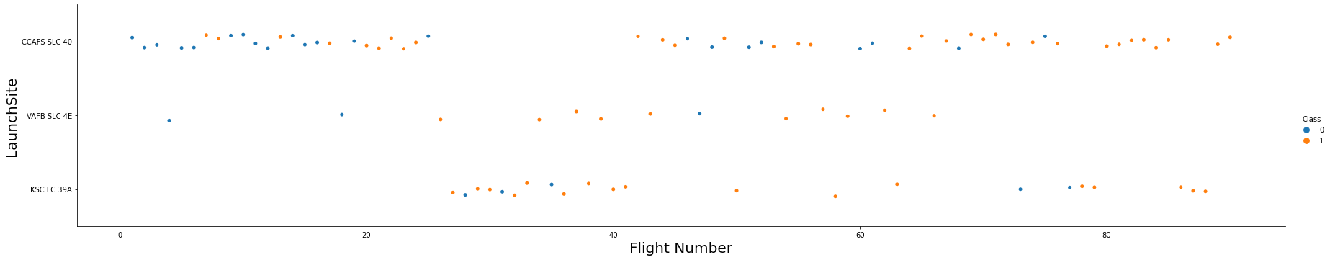
Flight Number vs. Launch Site
Scatter plot of Flight Number vs. Launch Site
Recent launches (flight numbers > 40 ) were more prone to success on CCAFS SLC 40 Launch Site;
Early launches (flight numbers 0 to 25) were more prone to fail and were also launched from CCAFS SLC 40;
Fewer launches were done on VAFB SLC 4E than in any other launch site, which proportionally gives it a better success ratio;
KSC LC 39A launch site was only used or started its activities after the last “twentieths” flight number failed on CCAFS SLC 40 site;
Activities returned to launch site CCAFS SLC 40 after the flight number 40 and a good success ratio started after flight number 60.

Slide 21
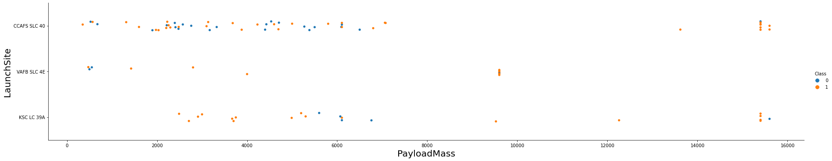
Payload vs. Launch Site
Scatter plot of Payload vs. Launch Site
For the VAFB-SLC launch site there are no rockets launched for heavy payload mass(greater than 10000)
The greater the payload for CCAFS SLC 40 higher the success rate.

Slide 22
Success Rate vs. Orbit Type
Bar chart for the success rate of each orbit type
Orbit PO has higher success rate, followed by ES-L1 then HEO and MEO to SSO then GEO.
LEO, ISS, GTO tie on success rate.
VLEO orbit has only success.
SO orbit has only failed.

Slide 23
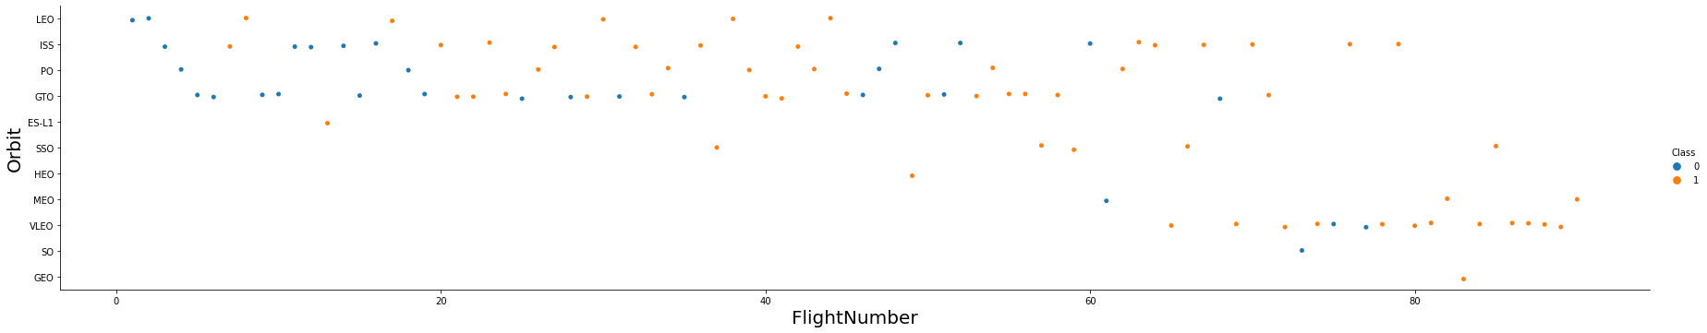
Flight Number vs. Orbit Type
Scatter plot of Flight number vs. Orbit type
In the LEO orbit the Success appears related to the number of flights; on the other hand, there seems to be no relationship between flight number when in GTO orbit.

Slide 24
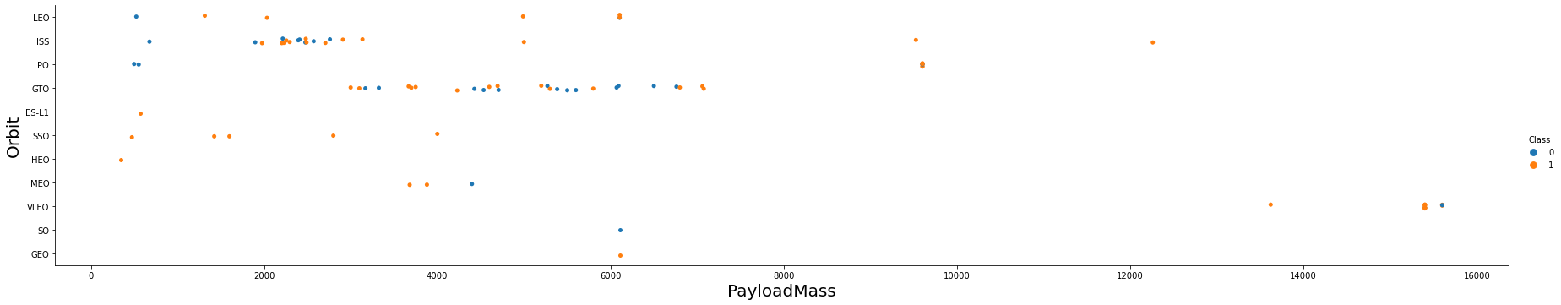
Payload vs. Orbit Type
Scatter plot of payload vs. orbit type
There is an increase of the successful landing accompanied by an increase on the payload for the orbits PO, LEO and ISS

Slide 25
Launch Success Yearly Trend
Line chart of yearly average success rate
From 2013 onwards there was a constantly increase on the success rate for SpaceX rocket launches with a slight decline in 2018 which was soon recovered in 2019

Slide 26
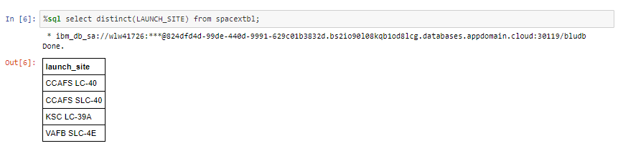
All Launch Site Names
Data selection using SQL using the function DISTINCT

Slide 27
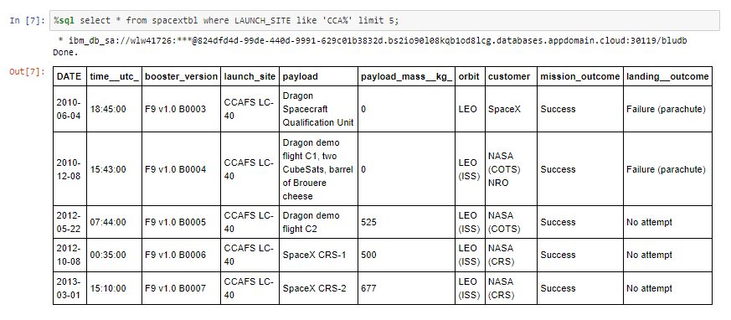
Launch Site Names Begin with 'CCA'
Data selection using SQL using the function LIMIT and the operator LIKE returning the first 5 records of launch sites beginning with `CCA`

Slide 28
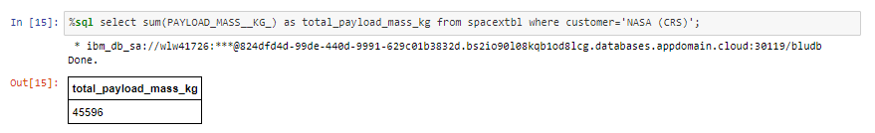
Total Payload Mass
Data selection using SQL to calculate the total payload carried by boosters from NASA using function SUM and where clause customer equal ‘NASA (CRS)’

Slide 29
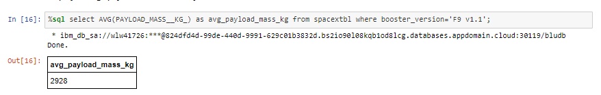
Average Payload Mass by F9 v1.1
Data selection using SQL to calculate the average payload mass carried by booster version F9 v1.1, using function AVG and where clause booster version equal ‘F9 v1.1’

Slide 30
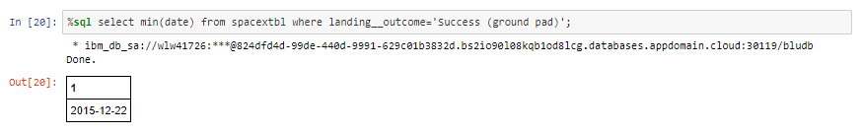
First Successful Ground Landing Date
Data selection using SQL to find the dates of the first successful landing outcome on ground pad (2015-12-22), utilizing a simple where clause on the attribute / column landing__outcome and the function MIN on date

Slide 31
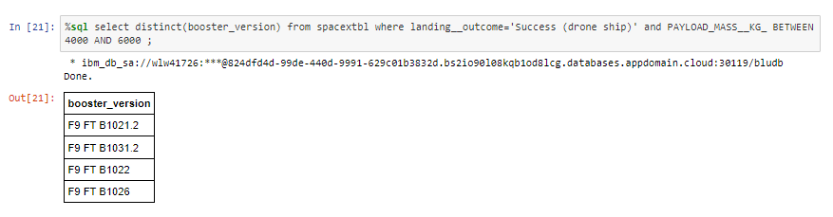
Successful Drone Ship Landing with Payload between 4000 and 6000
Data selection using SQL to list the names of boosters which have successfully landed on drone ship and had payload mass greater than 4000 but less than 6000, utilizing function DISTINCT on booster_version and BETWEEN for the desired values of payload_mass__kg

Slide 32
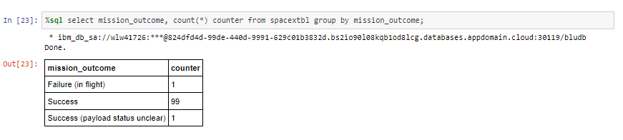
Total Number of Successful and Failure Mission Outcomes
Data selection using SQL to calculate the total number of successful and failure mission outcomes, via the function COUNT, creating a new column and GROUP BY on the mission_outcome
A total of 100 success if you disconsider the payload status and a single (1) failure in flight

Slide 33
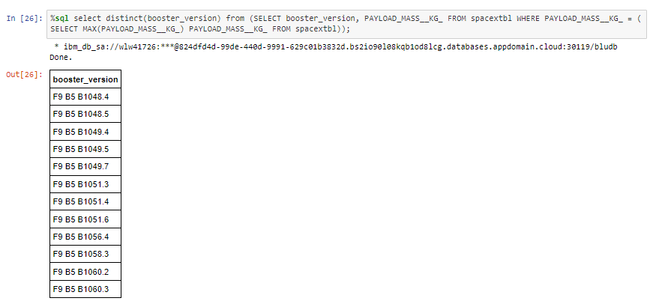
Boosters Carried Maximum Payload
Data selection with SQL to list the names of the booster which have carried the maximum payload mass, using DISTINCT function and a subquery to return the MAX payload.

Slide 34
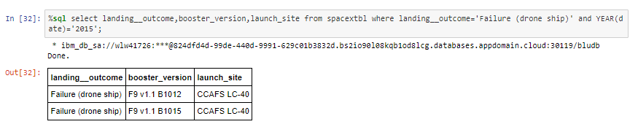
2015 Launch Records
Data selection with SQL to list the failed landing_outcomes in drone ship, their booster versions, and launch site names for in year 2015, using a simple where clause stating the values for each column (landing__outcome and date), we also used the function / format YEAR for the date column.

Slide 35
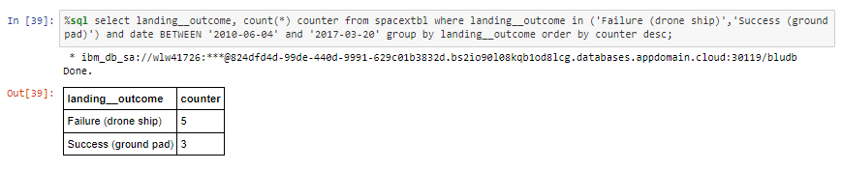
Rank Landing Outcomes Between 2010-06-04 and 2017-03-20
Data selection with SQL ranking the count of landing outcomes (such as Failure (drone ship) or Success (ground pad)) between the date 2010-06-04 and 2017-03-20, in descending order, by using the function COUNT and creating a column counter which returns the count, the function IN to specify the outcomes desired and the function BETWEEN to filter the date field, grouping it using the function GROUP BY on the outcome field, and ordering it with ORDER BY function.
Please note the “such as” values described were used as filters on the data selection

Slide 36

Section 3

Slide 37
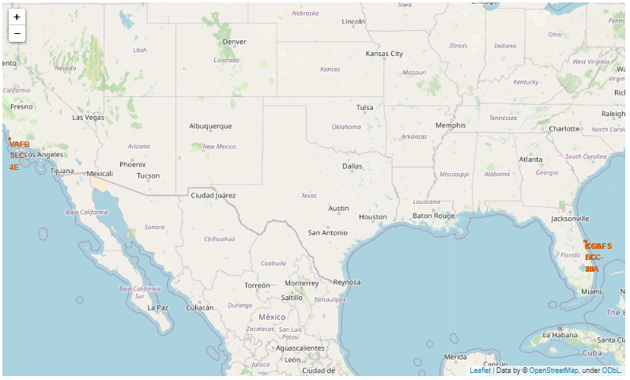
Launch Sites Geographical analysis
All SpaceX launch sites are situated on the northern hemisphere at the United States of America on its west coast in California and on its east coast in Florida. There is a higher success rate for the launches in Florida Cape Canaveral sites.
Which also shows that the closer to the Equator the better the result of the launch.
And the proximity analysis shows that the launch sites rely on infrastructure such as railroads and highways to operate and that for safety reasons they are far from overpopulated areas like cities

Slide 38
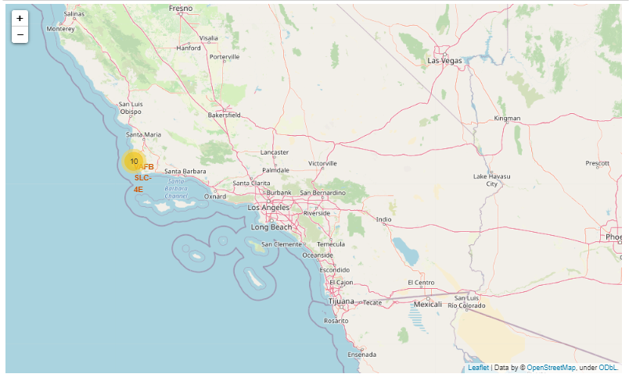
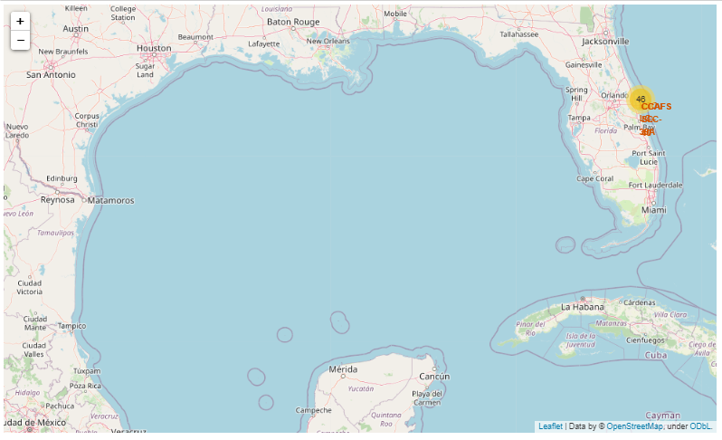
Launch Sites Geographical analysis

Slide 39
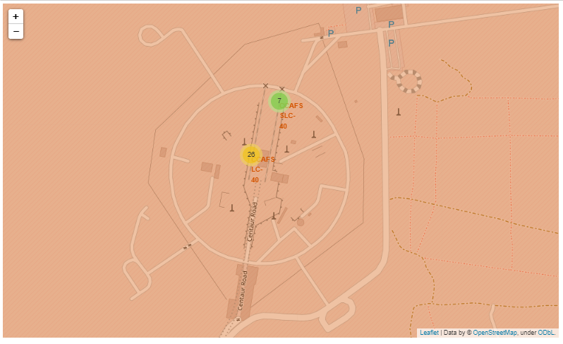
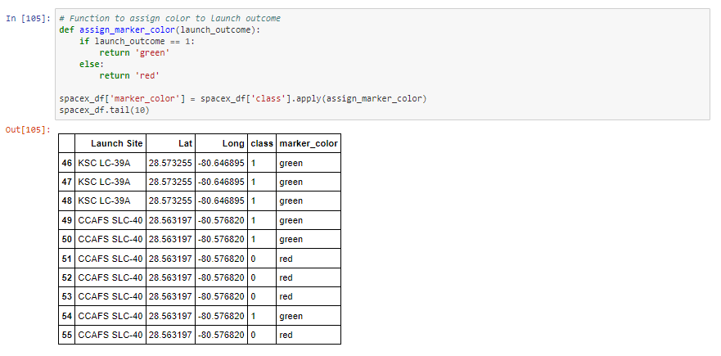
Launch Sites Geographical analysis
For some reason the icons for the colors did not render in the map, I believe it might be related to the zoom scale or the background tiles ; but the date frame was updated

Slide 40
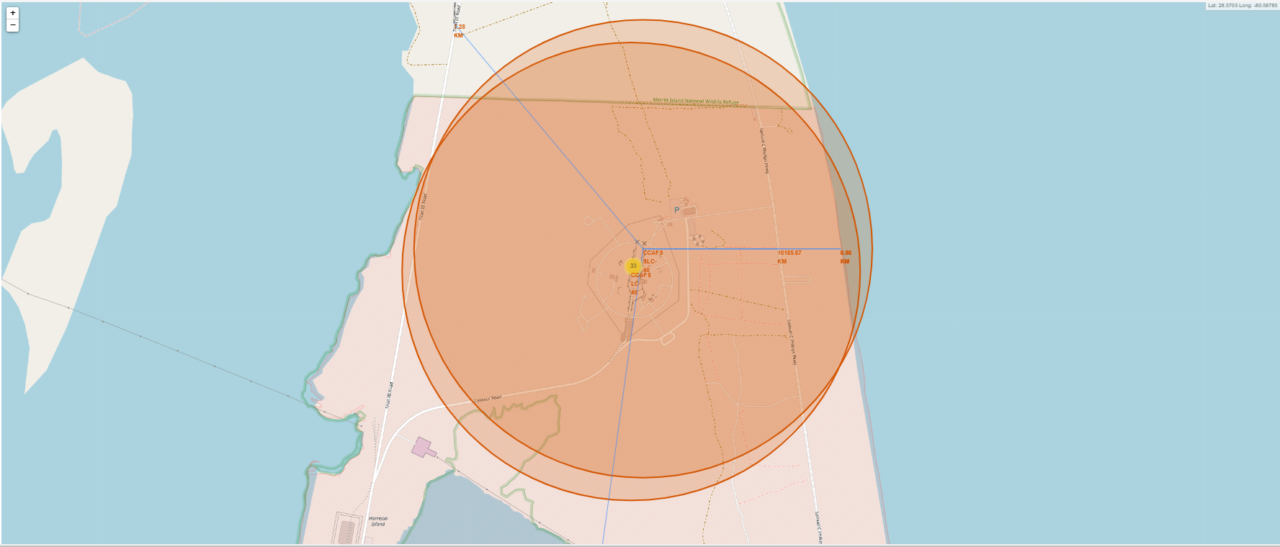
Launch Sites Geographical analysis
Distance from the Railroad: 1.28 km
Distance from the Railroad: 1 km
Distance from the Coast: 0.9 km

Slide 41
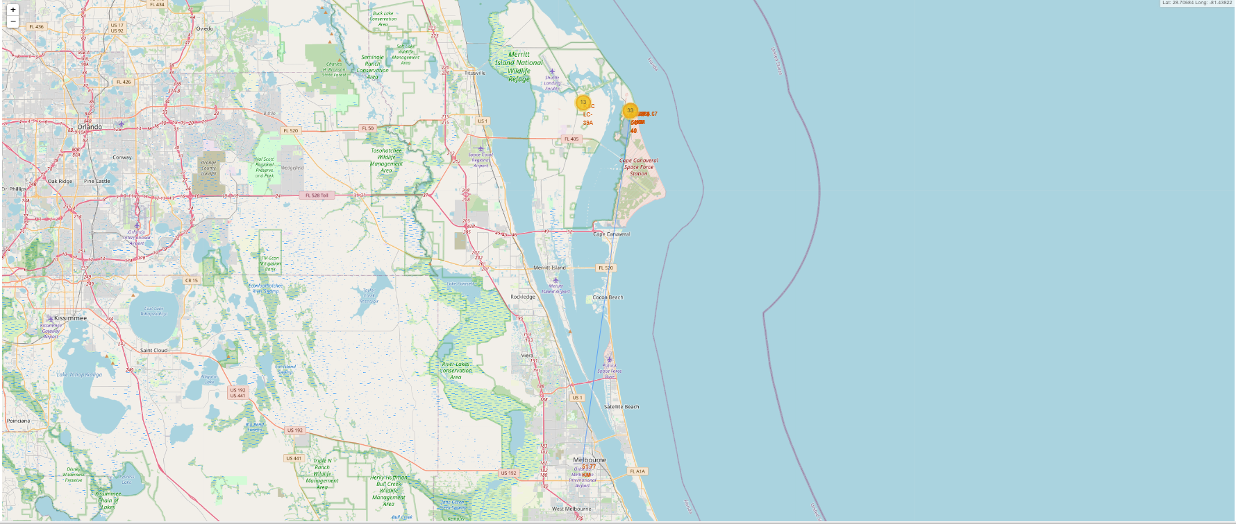
Launch Sites Geographical analysis
Distance from the City: 51.7 km

Slide 42

Section 4

Slide 43
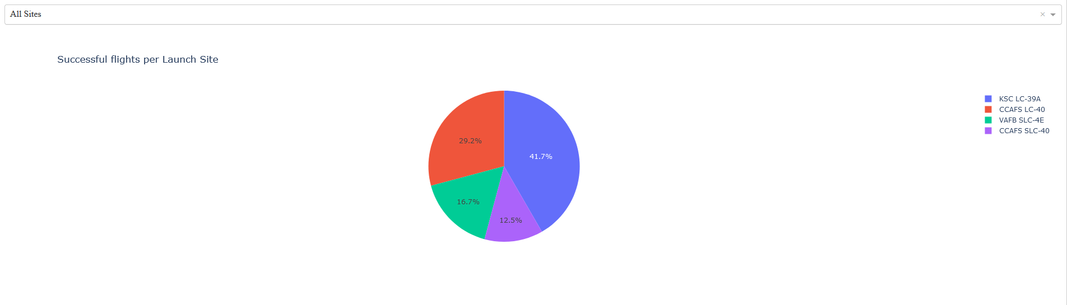
SpaceX Launch Records Dashboard
Dropdown component selection = ALL (label: “All sites”), used as input on callback app pie chart showing the Successful flights per Launch Site where KSC LC-39A has the best success rate. The pie chart allows us to quickly visualize the comparison of the success rate between launch sites
Which site has the largest successful launches? KSC LC-39A with 41.7%

Slide 44
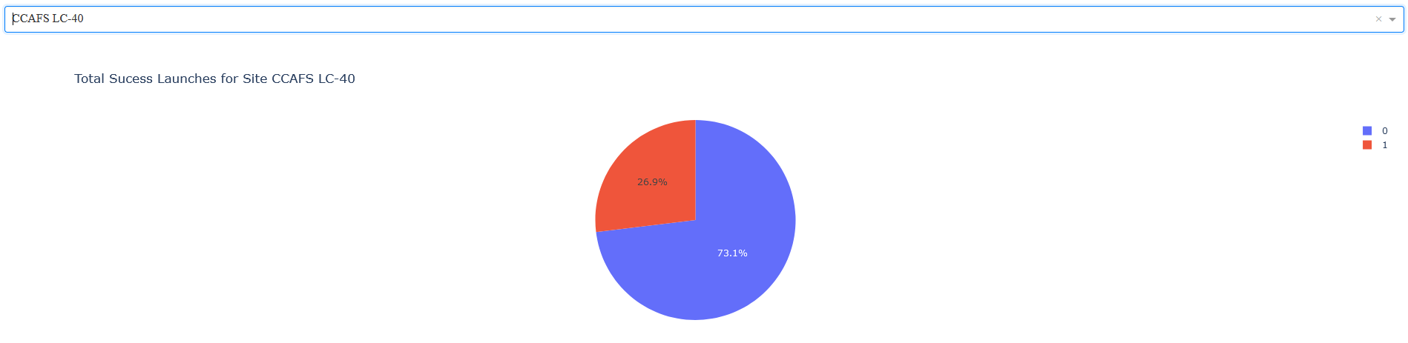
SpaceX Launch Records Dashboard
Dropdown component selection = CCAFS LC-40, used as input on callback app pie chart showing the Successful flights for Launch Site. Where we can see a 73.1% fail rate and 26.9% success. The pie chart allows us to quickly visualize the the success ratio on a launch sites
Which site has the highest launch success rate? CCAFS SLC-40 with 42.9 %

Slide 45
SpaceX Launch Records Dashboard
On the next slide we have two pictures of the scatter graph generated by the selection on a horizontal slider component showing the full Payload. The first range from 0 to 10000 and the second from 2500 to 7000, on a “All sites” selection from the dropdown component.
Range and selection were used as input on callback app showing the Correlation between Payload Mass (kg) and Success rate for all Launch Sites, on the scatter graph. Where we can identify:
Which payload range(s) has the highest launch success rate? 2500 - 5500
Which payload range(s) has the lowest launch success rate? 2000 - 3000
Which F9 Booster version (v1.0, v1.1, FT, B4, B5, etc.) has the highest launch success rate? FT

Slide 46
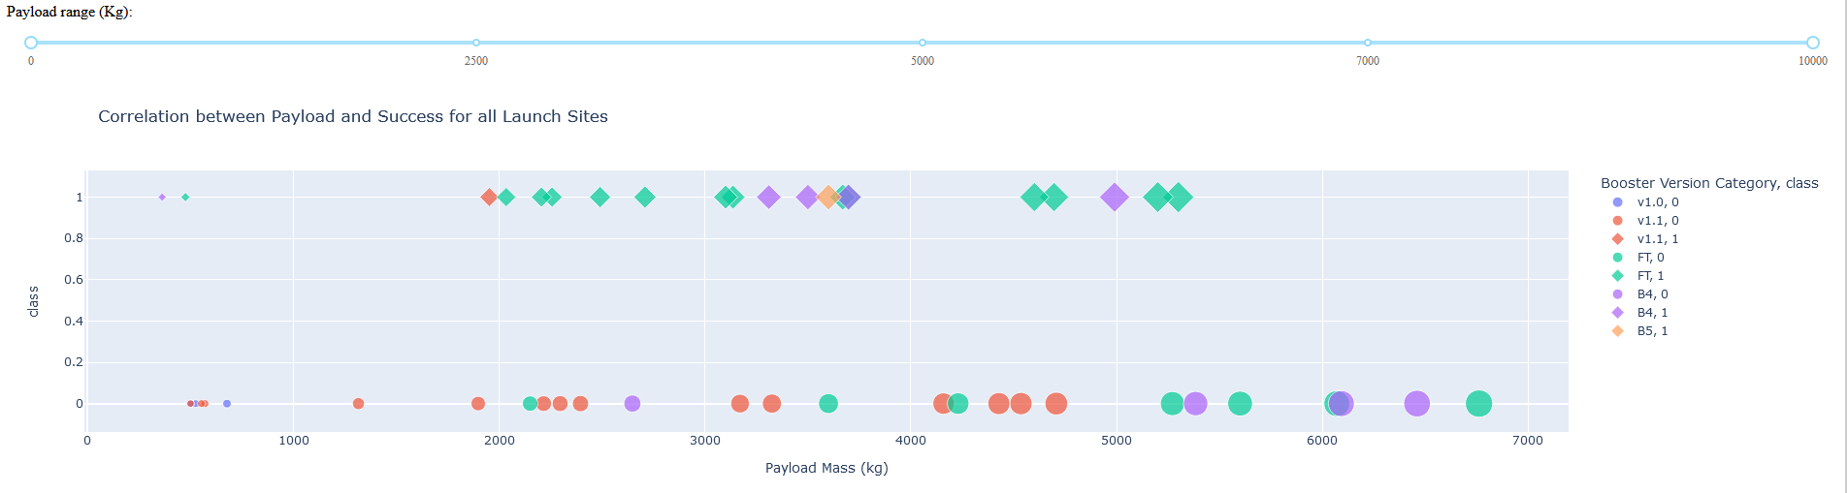
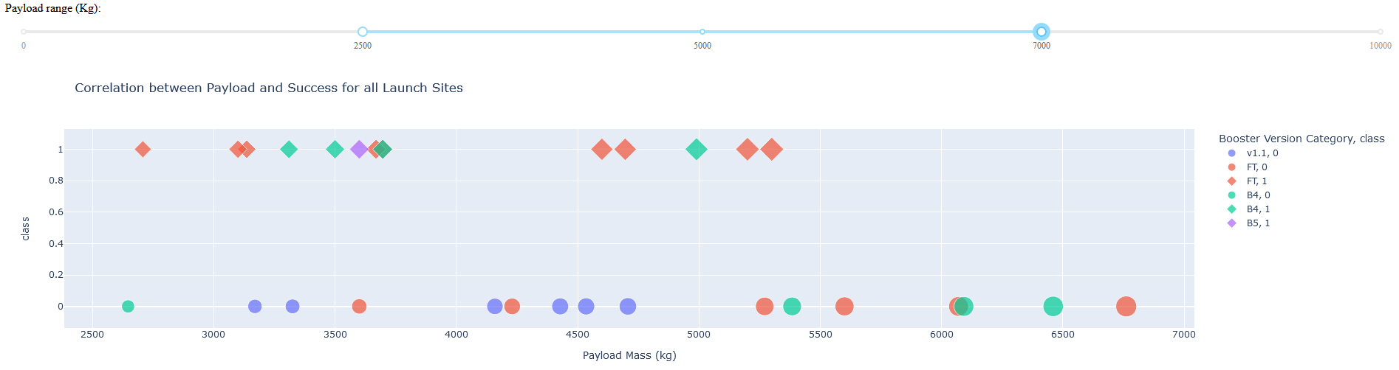
SpaceX Launch Records Dashboard

Slide 47

Section 5

Slide 48
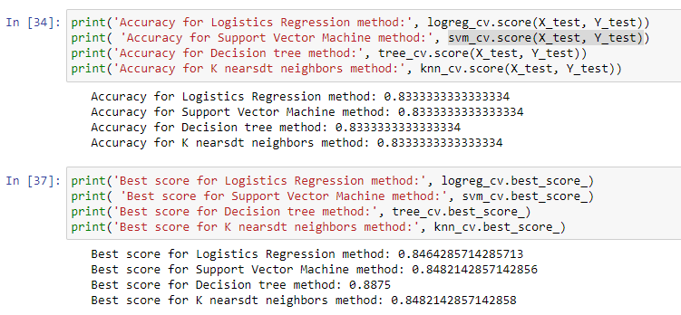
Classification Accuracy
The model with best score is Decision Tree, with 0.8875
The accuracy for all models was: 0.8333

Slide 49
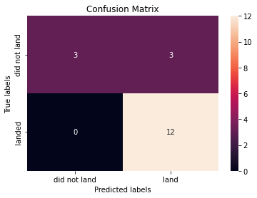
Confusion Matrix
As Decision Tree was the best performing model its Confusion Matrix shows two classes very distinguished. But we also see that the major problem is false positives, where failed landings are defined as successful by the classifier.

Slide 50
Conclusions
The greater the number of launches on a site, greater is also its success rate.
From 2013 onwards there was a constantly increase on the success rate for SpaceX rocket launches with a slight decline in 2018 which was soon recovered in 2019
Orbit PO has higher success rate, followed by ES-L1 then HEO and MEO to SSO then GEO.
Largest successful launches were found at KSC LC-39A site (41.7%)
The highest launch success rate was found at CCAFS SLC-40 site (42.9 %)
The payload range(s) with the highest launch success rate is 2500 - 5500
The payload range(s) with the lowest launch success rate 2000 - 3000
The F9 Booster version FT has the highest launch success rate
The model with best score is Decision Tree, with 0.8875
The accuracy for all models was: 0.8333
The average payload mass carried by booster version F9 v1.1 was 2928 kg

Slide 51
Appendix
GitHub link to all datasets used and notebooks created:
https://github.com/p00d33m/Coursera-IBM-DS-Capstone-2022

Slide 52


